Slide 1

TEAM 38 <Data Vaders>
Group Members:
Aleyna Kütük 23991
Yaren Su Saatçı 23838
Deniz Erden 21152
Modeling: https://colab.research.google.com/drive/1CDXSj22GSmDL81jP888LrVI4xO0Okrg1?usp=sharing
Visualization:
https://colab.research.google.com/drive/1jLlYFu9ii_wkeGwKI_xGy47dSsGjK85_?usp=sharing
TEAM 38 Data Vaders

Slide 2
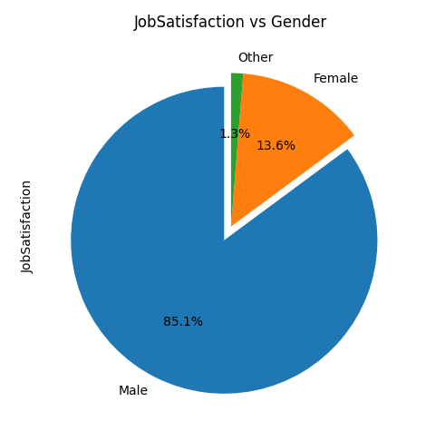
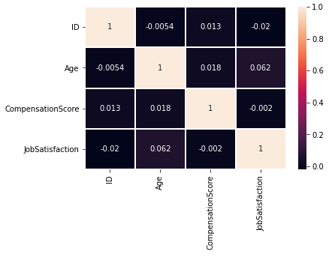
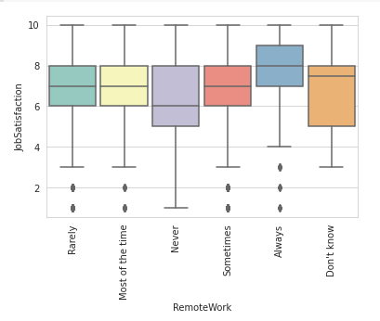

Slide 3
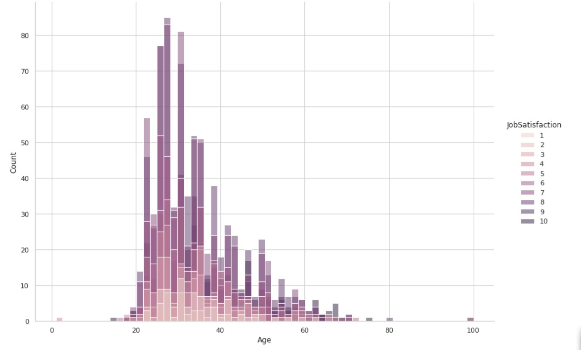
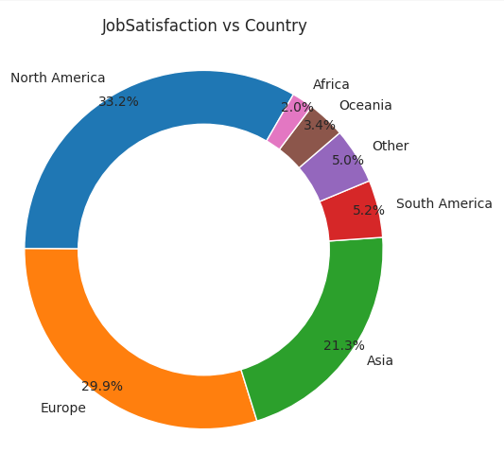

Slide 4
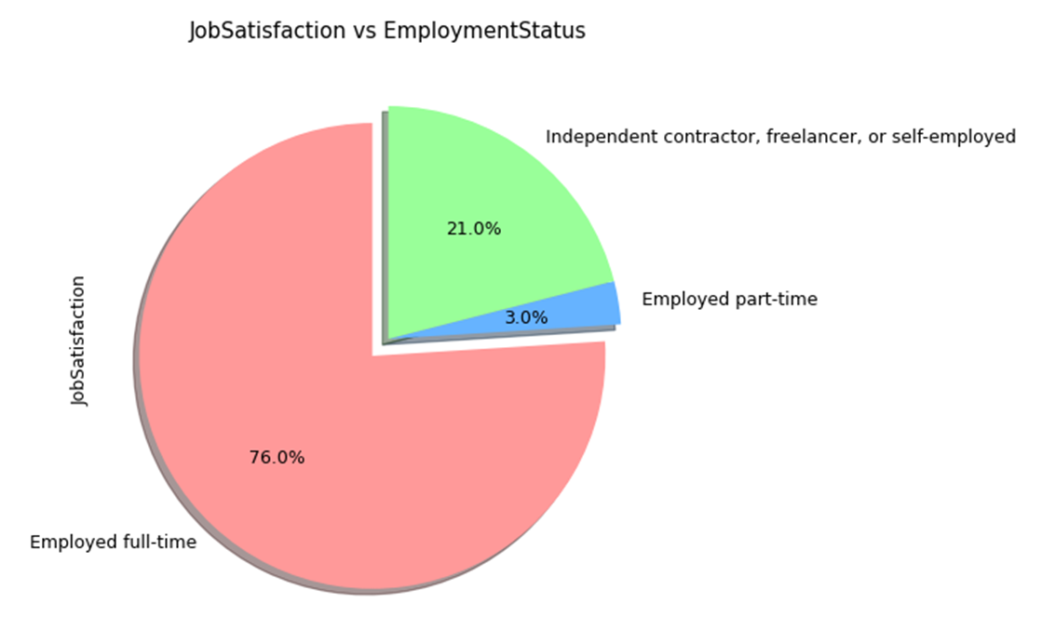
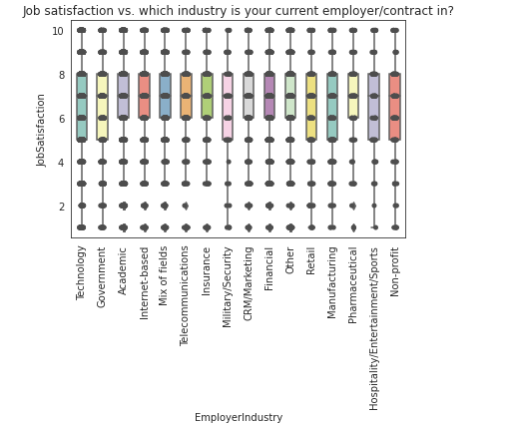
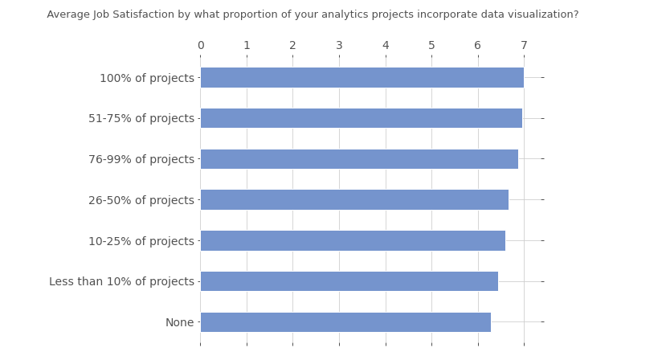

Slide 5
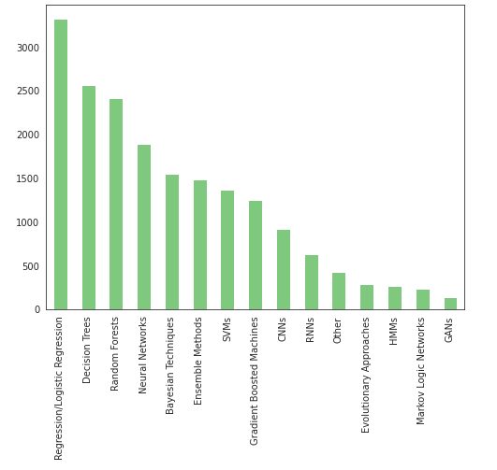
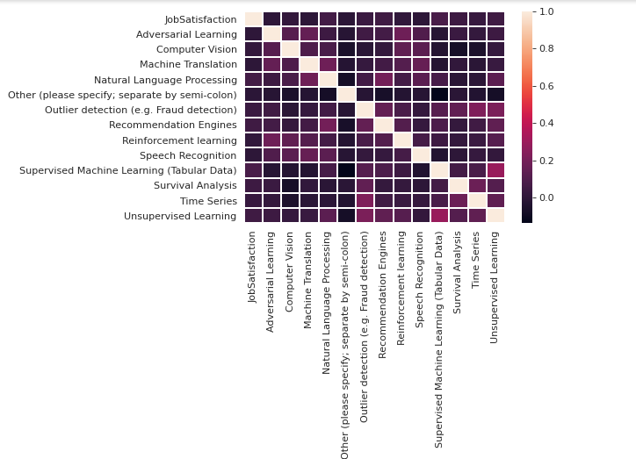

Slide 6
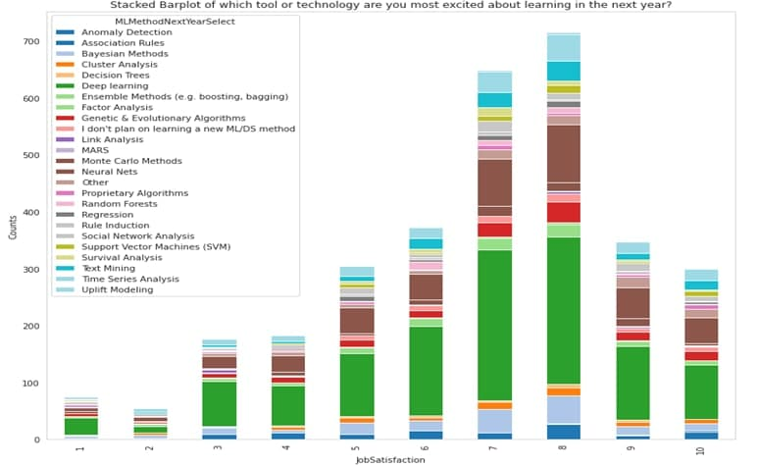
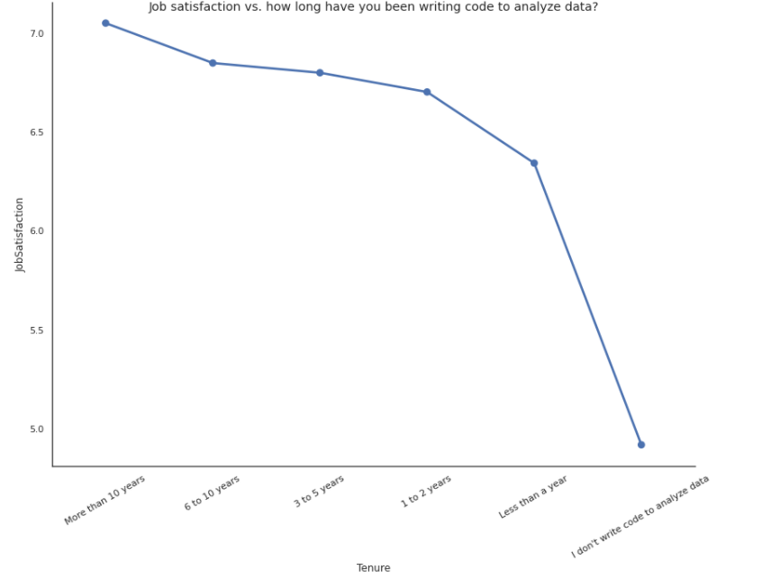

Slide 7
PreProcessing Summary
Some features has repeated values so we split those by “,” and then obtain new features which prevents unnecessary feature increase.
- 'CurrentEmployerType’ , 'WorkAlgorithmsSelect’
Some features are segmented into several ranges to increase usefulness:
- ‘Age’, ‘Country’
e.g ['Asia', 'North America', 'Europe', 'Other', 'South America', 'Oceania', 'Africa’] for Country,
['18-29', '30-39', '40-49', '50-59', '60-69', '70+’] for Age.
NaN values are filled by using KNNImputer with n_neighbors=3, which increased our prediction results compared to the method of filling with the mode of the feature.
Attributes are normalized to prevent distance measures from being dominated by one of the attributes. (e.g StandardScaler, MinMaxScaler)
Since MLMethodNextYearSelect, MLToolNextYearSelect and WorkDataVisualizations features have intensity for the first 4 answers, we classified the remaining answers as 'Other’.
We have mapped the features which has values can be ordered as ordinal features.

Slide 8
Feature Selection Summary
Some features were obviously uncorrelated. (e.g ID, CodeWriter)
Note: CodeWriter has just one unique answer for the whole train set: ‘Yes’
Features are get eliminated according to their pvalues being greater than a certain threshold ( pvalue > 0.05). (ANOVA f_oneway)
Features which have high percentage NaN values, are eliminated (mostly higher than %60)
Note: there was some useful features which contain NaN values higher than 60%, but we used those ones.
Some visualizations are used to decide on whether the feature correlated with the target or not
We used SelectKBest(score_func=chi2, k=10) to analyse which features have correlation with the target mostly.
Also, we have gone through and discussed every feature to keep or not.

Slide 9
The Most Useful Features for the target
Tenure
RemoteWork
WorkDataVisualizations
TitleFit
WorkProductionFrequency
WorkChallengeFrequencies
CurrentJobTitleSelect
TEAM 38 Data Vaders

Slide 10
ML Model | RMSE Scores
Elastic Regression | 2.0068074933554785
Ensemble Method | 1.9441428230294984
Ridge Regression | 2.0089516287446956
XGBoost Regression | 1.9899294923846569
Lasso Regression | 2.00649373313273
Kernel Ridge Regression | 1.9700440716089802
Bayesian Ridge Regression | 1.9747212712765039

Slide 11
Analysis of Data
There are fewer women than men in Data Science, but it is not surprising it is just informative.
Age is normally distributed and mostly people between 20’s and 40’s have higher job satisfaction, but this is also expected because this range is working age.
Most of the people wants to learn Deep Learning next year.
People who are writing code more years have higher job satisfaction.
Job Satisfaction is hard to decide by looking people previous degree so that Formal Education feature did not help much.
Although Major Select can be thought as related feature, when we analyze visualizations it is concluded that it is not informative.
Analysis of System Performance
We have tried several regression models and some of them give good results on training set. However, we observed that most of them have overfit issue. So, the most successful model is XGBRegressor used with RandomizedSearchCV. RandomizedSearchCV raised our score because it randomly selects combinations of hyperparameters and tests them to find the optimal hyperparameter values out of the randomly selected group. RandomizedSearchCV and XGBRegressor together solved our overfitting issue. We get better rmse score in test set which is 1.96093, compared to our previous trials with other models.

Slide 12
<strong>THANK YOU!</strong>
TEAM 38 Data Vaders

